Slide 1
Intermediate Code Generation

Slide 2
OUTLINE
Intermediate code : need, types, Syntax directed translation scheme,
Intermediate code generation for
assignment statement,
declaration statement,
Boolean expression,
if-else statement,
do -while statement,
array assignment.

Slide 3
Compiler Architecture
Intermediate Code
Scanner
(lexical
analysis)
tokens
Parser
(syntax
analysis)
Syntactic
structure
Semantic
Analysis
(IC generator)
Code
Generator
Source
language
Target
language
Intermediate Code
Intermediate Code
Code
Optimizer
Symbol
Table

Slide 4
Intermediate Code Generation
After syntax and semantic analysis, some compilers generate an explicit intermediate representation of the source program.
ICG is not machine language, but can be somewhat similar for many languages.
e.g. GCC compiler. Family of GNU compilers use same form of ICG.
Advantage is that, we can write single code optimizer for many languages, if ICG is of same form.
two important properties: It should be easy to produce and it should be easy to translate into target program.

Slide 5
Summary of Front End
Lexical Analyzer (Scanner)
+
Syntax Analyzer (Parser)
+ Semantic Analyzer
Front
End
Abstract Syntax Tree w/Attributes
Intermediate-code Generator
Error
Message
Non-optimized Intermediate Code

Slide 6
Intermediate Code
Similar terms: Intermediate representation, intermediate language
Ties the front and back ends together
Explains how SDT methods can be used to translate into an intermediate form.
So, ICG can be folded into parsing, if desired.

Slide 7
Advantages of Using an Intermediate Language
. Optimization - reuse intermediate code optimizers in compilers for different languages and different machines.
Note: the terms “intermediate code”, “intermediate language”, and “intermediate representation” are all used interchangeably.

Slide 8
Intermediate Code Generation(IMPORTANT)
Intermediate codes are machine independent codes, but close to machine instructions.
Program in a source language is converted to an equivalent program in an intermediate language by the intermediate code generator.
Intermediate language can be many different languages, and the designer of the compiler decides this intermediate language.
Intermediate Code can create temporary variables to store sub-expression results.
syntax trees can be used as an intermediate language.
postfix notation can be used as an intermediate language.
three-address code (Quadruples) or triple codes can be used as an intermediate language
Quadruples are close to machine instructions, but they are not actual machine instructions.

Slide 9
Intermediate Code Generation(IMPORTANT)
some programming languages have well defined intermediate languages.
java – java virtual machine
prolog – warren abstract machine
In fact, there are byte-code emulators to execute instructions in these intermediate languages.

Slide 10
Intermediate Languages Types
Graphical Intermediate Representations:
Abstract Syntax trees (Syntax trees)
DAGs (Directed Acyclic Graphs)
Control Flow Graphs
Linearized Intermediate Representations :
Stack based (postfix)
Three address code (quadruples)

Slide 11
Linearized Intermediate Code
Infix: 2*Y-X , Postfix Notation: 2Y*X-
1) Stack based (one address used) – compact
1. push 2 in stack
2. push y in stack
3. Multiply and push result
4. push x in stack
5. Subtract and push result
2) Three address (quadruples) – up to three operands used and one operator
1. t1 := 2
2. t2 := y
3. t3 := t1 * t2
4. t4 := x
5. t5 := t4 – t3

Slide 12
Linearized Intermediate Code
Postfix Notation(stack based)
Infix Notation:
a := b *-c + b*-c
Postfix Notation:
abc uminus * bc uminus * + :=
OR
abc - * bc - * + :=

Slide 13
Three address (quadruples)
Expression: (A+B*C) + (-B*A) - B
Quadruple notation:
1. T1 := B * C
2. T2 = A + T1
3. T3 = - B
4. T4 = T3 * A
5. T5 = T2 + T4
6. T6 = T5 – B

Slide 14
Graphical Intermediate Representations
Abstract Syntax Trees (AST) –
It retains essential structure of the parse tree, eliminating unneeded nodes.
Syntax trees are called as Abstract Syntax Trees because-
They are abstract representation of the parse trees.
They do not provide every characteristic information from the real syntax.
For example- no rule nodes, no parenthesis etc.

Slide 15
Graphical Intermediate Representations
Directed Acyclic Graphs (DAG) – compacted AST to avoid duplication – smaller footprint as well
Control flow graphs (CFG) – explicitly model control flow

Slide 16
Syntax tree vs Three Address Code
Expression: (A+B*C) + (-B*A) - B
_
+
B
T1 := B * C
T2 = A + T1
T3 = - B
T4 = T3 * A
T5 = T2 + T4
T6 = T5 – B
+
*
_
A
*
A
B
C
B
Three address code (Quadruple) is a linearized representation of a syntax tree (or a DAG) in which explicit names (temporaries) correspond to the interior nodes of the graph.

Slide 17
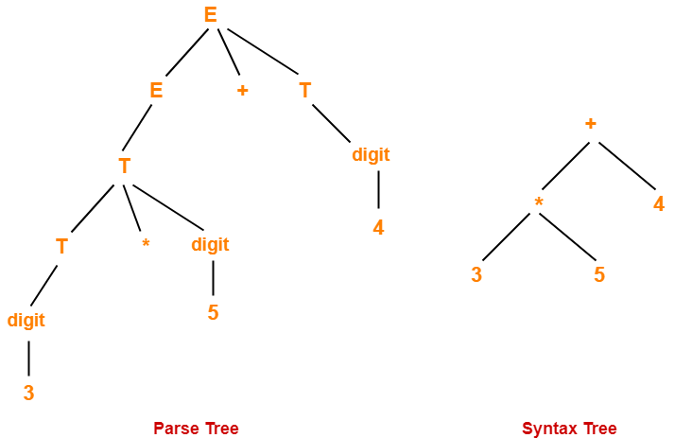
Abstract Syntax Trees
Syntax trees are abstract or compact representation of parse trees.
E->E+T|T
T-> T*digit|digit

Slide 18
Parse Tree and Syntax tree
Considering the following grammar-
E → E + T | T
T → T * F | F
F → ( E ) | id
Generate the following for the string id + id * id
Parse tree
Syntax tree

Slide 19
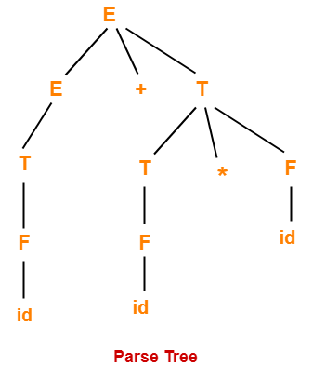
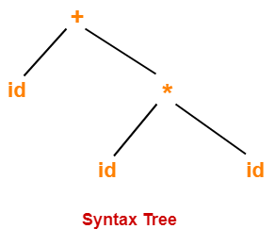
Abstract Syntax Trees

Slide 20
Parse Trees Vs Syntax Trees
Parse Tree | Syntax Tree
Parse tree is a graphical representation of the replacement process in a derivation.
Syntax tree is the compact form of a parse tree.
Each interior node represents a grammar rule.
Each leaf node represents a terminal.
Each interior node represents an operator.
Each leaf node represents an operand.
Parse trees provide every characteristic information from the real syntax.
Syntax trees do not provide every characteristic information from the real syntax.
Parse trees are comparatively less dense than syntax trees.
Syntax trees are comparatively more dense than parse trees.

Slide 21
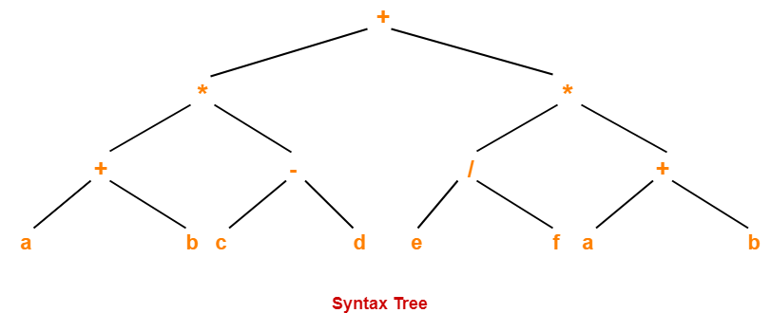
Abstract Syntax Trees-
( a + b ) * ( c – d ) + ( ( e / f ) * ( a + b ) )

Slide 22
Directed Acyclic Graph
Directed Acyclic Graph (DAG) is a special kind of Abstract Syntax Tree.
Directed Acyclic Graph determines the sub-expressions that are commonly used. (i.e. common sub-expressions).
A DAG is usually constructed using Three Address Code (Quadruple).
Transformations such as dead code elimination and common sub expression elimination are then applied.

Slide 23
Rules for the construction of DAGs
Rule-01:
In a DAG,
Interior nodes always represent the operators.
Exterior nodes (leaf nodes) always represent the names, identifiers or constants.
Rule-02:
While constructing a DAG,
A check is made to find if there exists any node with the same value.
A new node is created only when there does not exist any node with the same value.
This action helps in detecting the common sub-expressions and avoiding the re-computation of the same.
Rule-03:
The assignment instructions of the form x:=y are not performed unless they are necessary.

Slide 24
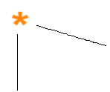
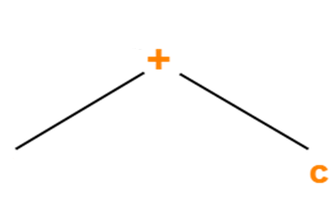
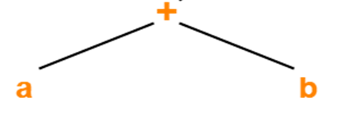
DAG
Expression: ( a + b ) * ( a + b + c )
Three Address Code for the given expression is-
T1 = a + b
T2 = T1 + c
T3 = T1 x T2

Slide 25
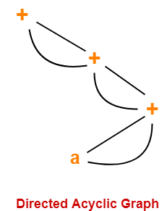
DAG
Expression:( ( ( a + a ) + ( a + a ) ) + ( ( a + a ) + ( a + a ) ) )

Slide 26
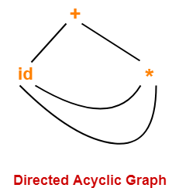
Expression: id + id x id

Slide 27
ASTs and DAGs
Expression: a := b *-c + b*-c
:=
:=
a
+
a
+
*
*
*
b
- (uni)
b
- (uni)
b
- (uni)
c
c
c
AST
DAG

Slide 28
DAG vs. Three address code
Expression: D = ((A+B*C) + (A*B*C))/ -C
=
T1 := A
T2 := C
T3 := B * T2
T4 := T1+T3
T5 := T1*T3
T6 := T4 + T5
T7 := – T2
T8 := T6 / T7
D := T8
T1 := B * C
T2 := A+T1
T3 := A*T1
T4 := T2+T3
T5 := – C
T6 := T4 / T5
D := T6
D
/
+
_
+
*
*
A
B
C
Question: Which IR code sequence is better?

Slide 29
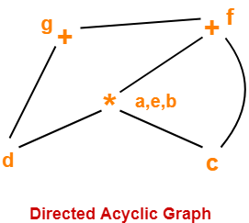
DAG
Consider the following block and construct a DAG for it-
(1) a = b x c
(2) d = b
(3) e = d x c
(4) b = e
(5) f = b + c
(6) g = f + d

Slide 30
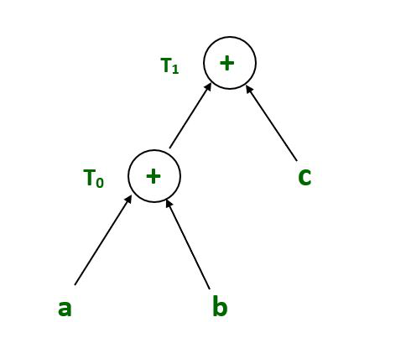
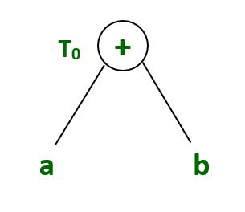
DAG
T₀ = a + b —Expression 1 T₁ = T₀ + c —-Expression 2 d = T₀ + T₁ —–Expression 3
Expression 1:
T₀ = a + b
Expression 2:
T₁ = T₀ + c

Slide 31
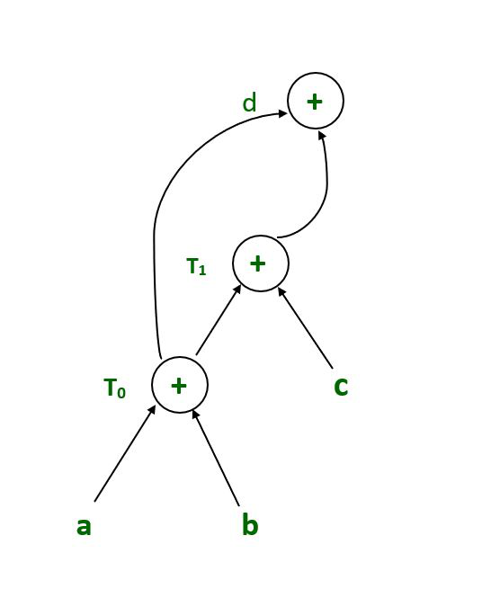
DAG
Expression 3 :
d = T₀ + T₁

Slide 32
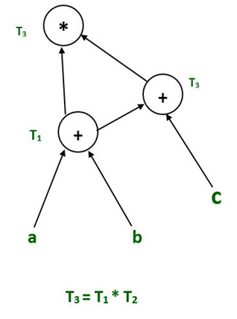
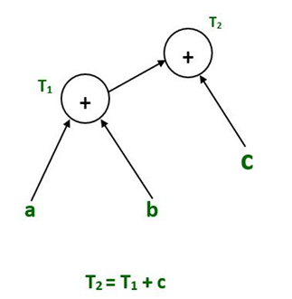
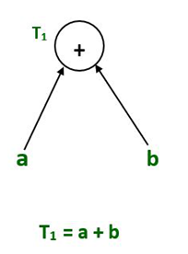
DAG
Example:
T₁ = a + b T₂ = T1 + c T₃ = T1 x T2

Slide 33
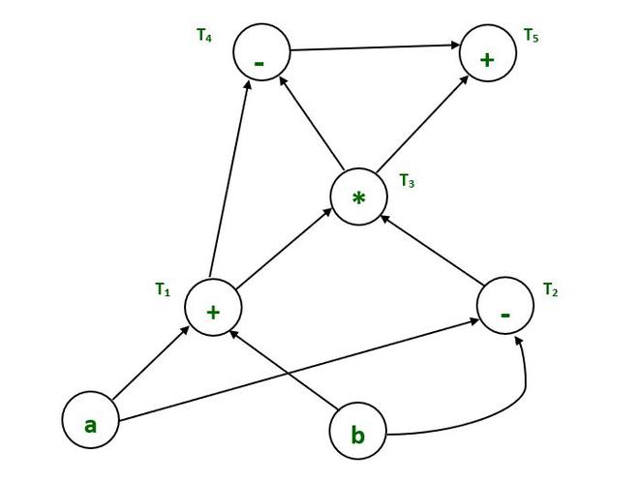
DAG
T₁ = a + b T₂ = a – b T₃ = T₁ * T₂ T₄ = T₁ – T₃ T₅ = T₄ + T₃

Slide 34
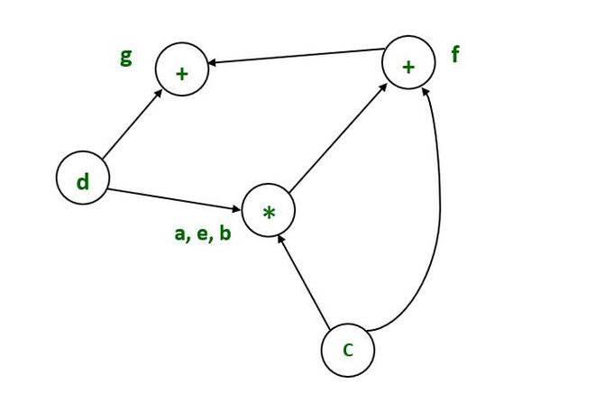
DAG
Example :
a = b x c d = b e = d x c b = e f = b + c g = f + d

Slide 35
Application of Directed Acyclic Graph:
Directed acyclic graph determines the sub-expressions that are commonly used.
Directed acyclic graph determines the names used within the block as well as the names computed outside the block.
Determines which statements in the block may have their computed value outside the block.
Code can be represented by a Directed acyclic graph that describes the inputs and outputs of each of the arithmetic operations performed within the code; this representation allows the compiler to perform common sub-expression elimination efficiently.
Several programming languages describe value systems that are linked together by a directed acyclic graph. When one value changes, its successors are recalculated; each value in the DAG is evaluated as a function of its predecessors.

Slide 36
Applications of SDD: (Constructing Syntax Trees for expressions)
The construction of a syntax tree is same as the translation of the expression into postfix form.
Node is created for each sub-expression.
Each node is implemented as a record with several fields.
Node for operator: three fields: first label (actual operator), second & third are pointer to two operands (nodes for operands).

Slide 37
Applications of SDD: (Constructing Syntax Trees for expressions)
Three functions to create nodes of syntax trees:
1) mknode (op, left, right): creates operator node with label op and two fields containing pointer to left and right.
2) mkleaf (id, entry): creates identifier node with label id and a pointer to symbol table entry for that identifier.
3) mkleaf (num, val): creates number node with label num and a field with the value of the number.

Slide 38
Syntax tree for expression
Expression: a-4+c
p1, p2,…,p5 are pointers to nodes, entrya and entryc are pointers to the symbol tabel entry. Each function returns pointers to new node created.
p1:= mkleaf(id, entrya); 4) p4 := mkleaf (id, entryc);
p2 := mkleaf(num, 4); 5) p5 := mknode (‘+’, p3, p4);
p3 := mknode(‘-’,p1,p2);
p5
p3 p4
p1 p2
+
-
id
To entry for ‘c’ in symbol table
id
num
4
To entry for ‘a’ in symbol table

Slide 39
Syntax Directed Definition for the given expression
Production Semantic Rules
E→ E₁ + T E.nptr:=mknode(‘+’,E1.nptr,T.nptr)
E → E₁ - T E.nptr:=mknode(‘-’,E1.nptr,T.nptr)
E → T E.nptr:=T.nptr
T → ( E ) T.nptr:=E.nptr
T → id T.nptr:=mkleaf(id, id.entry)
T → num T.nptr:=mkleaf(num, num.val)

Slide 40
Construction of syntax tree for a-4+c
E.nptr
+
E.nptr
-
E.nptr
T.nptr
id
T.nptr
num
T.nptr
id
+
-
id
To entry for ‘c’
id
num
4
To entry for ‘a’

Slide 41
Three-Address Code (Quadruples)
A quadruple is:
x := y op z
where x, y and z are names, constants or compiler-generated temporaries; op is any operator.
Another notation for quadruples (much better notation because it looks like a machine code instruction)
op y, z, x
apply operator op to y and z, and store the result in x.
Eg. x+y*z in TAC is t1:=y*z, t2:=x+t1
The term “three-address code” means each statement usually contains three addresses (two for operands, one for the result).
Linearized representation of syntax tree or a DAG.

Slide 42
Implementation of Three Address Code
Triples
• Three fields: op, arg1, and arg2. Result become implicit.
• arg1 and arg2 are either pointers to the symbol table or index/pointers to the triple structure.
Example: d = a + (b*c)
1. * b, c
2 . + a, (1)
3. assign d, (2)
• No explicit temporary names used.
• Need more than one entries for ternary operations such as x:=y[i], a=b+c, x[i]=y, … etc.

Slide 43
Three-Address Code (Quadraples)
A quadraple is:
x := y op z
where x, y and z are names, constants or compiler-generated temporaries; op is any operator.
But we may also use the following notation for quadraples (much better notation because it looks like a machine code instruction)
op y,z,x
apply operator op to y and z, and store the result in x.
We use the term “three-address code” because each statement usually contains three addresses (two for operands, one for the result).

Slide 44
Three-Address Statements
Binary Operator: op y,z,result or result := y op z
where op is a binary arithmetic or logical operator. This binary operator is applied to y and z, and the result of the operation is stored in result.
Ex: add a,b,c or c:=a+b
gt a,b,c or c:=a>b
Unary Operator: op y,,result or result := op y
where op is a unary arithmetic or logical operator. This unary operator is applied to y, and the result of the operation is stored in result.
Ex: uminus a,,c or c:=-a
not a,,c or c!=a
inttoreal a,,c or c=inttoreal(a)

Slide 45
Three-Address Statements (cont.)
Move Operator: mov y,,result or result := y
where the content of y is copied into result.
Ex: mov a,,c or c:=a
movi a,,c
movr a,,c
Unconditional Jumps: jmp ,,L or goto L
We will jump to the three-address code with the label L, and the execution continues from that statement.
Ex: jmp ,,L1 // jump to L1 or goto L1
jmp ,,7 // jump to the statement 7 or goto 7

Slide 46
Three-Address Statements (cont.)
Conditional Jumps: jmprelop y,z,L or if y relop z goto L
We will jump to the three-address code with the label L if the result of y relop z is true, and the execution continues from that statement. If the result is false, the execution continues from the statement following this conditional jump statement.
Ex: jmpgt y,z,L1 // jump to L1 if y>z or if y>z goto L1
jmpgte y,z,L1 // jump to L1 if y>=z or if y>=z goto L1
jmpe y,z,L1 // jump to L1 if y==z or if y==z goto L1
jmpne y,z,L1 // jump to L1 if y!=z or if y!=z goto L1
Our relational operator can also be a unary operator.
jmpnz y,,L1 // jump to L1 if y is not zero or if y!=0 goto L1
jmpz y,,L1 // jump to L1 if y is zero or if y==0 goto L1
jmpt y,,L1 // jump to L1 if y is true or if y goto L1
jmpf y,,L1 // jump to L1 if y is false or if !y goto L1

Slide 47
Three-Address Statements (cont.)
Procedure Parameters: param x,, or param x
Procedure Calls: call p,n, or call p,n
where x is an actual parameter, we invoke the procedure p with n parameters.
Ex: param x₁,,
param x₂,,
➔ p(x₁,...,x_{n})
param x_{n},,
call p,n,
Function call: ICG (1):- ICG(2):-
fun1(x+1,y); ➔ add x,1,t1 t1:=x+1
param t1,, param t1
param y,, param y
call fun1,2, call fun1,2

Slide 48
Three-Address Statements (cont.)
Indexed Assignments:
move y[i],,x or x := y[i]
move x,,y[i] or y[i] := x
Address and Pointer Assignments:
moveaddr y,,x or x := &y
movecont y,,x or x := *y

Slide 49
Example: Three Address Code Generation
while (A<C && B>D) 1. if A<C goto 3
{ 2. goto 15
if (A==3) 3. if B>D goto 5
C=C+1; 4. goto 15
else 5. if A==3 goto 7
{ ICG 6. goto 10
while (A<=D) 7. t1:=C+1
A=A+3; 8. C:=t1
} 9. goto 1
} 10. if A<=D goto 12
11. goto 1
12. t2:= A+3
13. A:=t2
14. goto 1
15. end

Slide 50
Three Address Codes - Example
x:=1; 01: mov 1,,x 1. t1:=1
y:=x+10; 02: add x,10,t1 2. X:=t1
while (x<y) { ➔ 03: mov t1,,y 3. t2:=t1+10
x:=x+1; 04: lt x,y,t2 4. Y:=t2
if (x%2==1) then y:=y+1; 05: jmpf t2,,17 5. if X<Y goto 7
else y:=y-2; 06: add x,1,t3 6. goto 14
} 07: mov t3,,x 7. t3:=X+1
08: mod x,2,t4 8. t4:=X%2
09: eq t4,1,t5 9. if t4==1 goto 12
10: jmpf t5,,14 10. t5:=Y-2
11: add y,1,t6 11. Y:=t5
12: mov t6,,y 12. t6:=Y+1
13: jmp ,,16 13. Y:=t6
14: sub y,2,t7 14. end
15: mov t7,,y
16: jmp ,,4
17: stop

Slide 51
Arrays
Elements of arrays can be accessed quickly if the elements are stored in a block of consecutive locations.
A one-dimensional array A:
base_{A} low i width
base_{A} -is the address of the first location of the array A,
width -is the width of each array element.
low -is the index of the first array element
location of A[i] ➔ base_{A}+(i-low)*width
 | … |  | …

Slide 52
Arrays (cont…..)
base_{A}+(i-low)*width
can be re-written as i*width + (base_{A}-low*width)
So, the location of A[i] can be computed at the run-time by evaluating the formula i*width+c where c is (base_{A}-low*width) which is evaluated at compile-time.
Intermediate code generator should produce the code to evaluate this formula i*width+c (one multiplication and one addition operation).
ICG (three address code) for A[i] is:
t1:=baseaddr(A) or t1:=addr(A)
t2:=t1[i*width] i.e. t2:=t1[i*2] , if array is of int type where i is index

Slide 53
Two-Dimensional Arrays
A two-dimensional array can be stored in
either row-major (row-by-row) or
column-major (column-by-column).
Most of the programming languages use row-major method.
Row-major representation of a two-dimensional array:
row₁ row₂ row_{n}

Slide 54
1 2 3
Matrix A:-
1
2
3
4
1 | 2 | 3
4 | 5 | 6
7 | 8 | 9
10 | 11 | 12
A[2][3]
1 | 2 | 3 | 4 | 5 | 6 |  | 10 | 11 | 12
Assume that the array index starts from 1.
Location of A[2][3]=
=base_{A}+ ((i₁-low₁)*n₂+i₂-low₂)*width
=100+ ((2-1)*3 + 3-1)*2
= 100 + (3+2)*2
=100+10= 110

Slide 55
Two-Dimensional Arrays (cont...)
The location (address) of A[i₁,i₂] or A[i₁][i₂] is:-
base_{A}+ ((i₁-low₁)*n₂+i₂-low₂)*width
base_{A} is the location of the array A.
low₁ is the index of the first row
low₂ is the index of the first column
n₂ is the number of elements in each row
width is the width of each array element
Again, this formula can be re-written as
((i₁*n₂)+i₂)*width + (base_{A}-((low₁*n₂)+low₂)*width)
should be computed at run-time can be computed at compile-time

Slide 56
Example
ICG (three address code) for A[i][j]=B[i][j]+C[i][j]*10 is:
1. t1:=baseaddr(B) or t1:=addr(B)
2. t2:=baseaddr(C) or t2:=addr(C)
3. t3:=baseaddr(A) or t3:=addr(A)
// TAC for calculation of [i][j], where i, j starts from 0
4. t4:=i*n, where n is no. of elements in each row
5. t5:=t4+j where j is column index
6. t6:=t5*2, where 2 is width of integer if array is of type “int”
7. t7:=t2[t6]
8. t8:=t7*10
9. t9:=t1[t6]
10. t10:=t8+t9
11. t3[t6]:=t10

Slide 57
Multi-Dimensional Arrays
In general, the location of A[i₁,i₂,...,i_{k}] is
(( ... ((i₁*n₂)+i₂) ...)*n_{k}+i_{k})*width + (base_{A}-((...((low₁*n₁)+low₂)...)*n_{k}+low_{k})*width)
So, the intermediate code generator should produce the codes to evaluate the following formula (to find the location of A[i₁,i₂,...,i_{k}]) :
(( ... ((i₁*n₂)+i₂) ...)*n_{k}+i_{k})*width + c
To evaluate the (( ... ((i₁*n₂)+i₂) ...)*n_{k}+i_{k} portion of this formula, we can use the recurrence equation:
e₁ = i₁
e_{m} = e_{m-1} * n_{m} + i_{m}

Slide 58
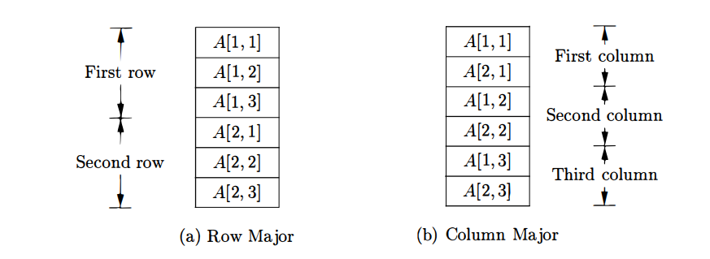
Translation of Array References

Slide 59
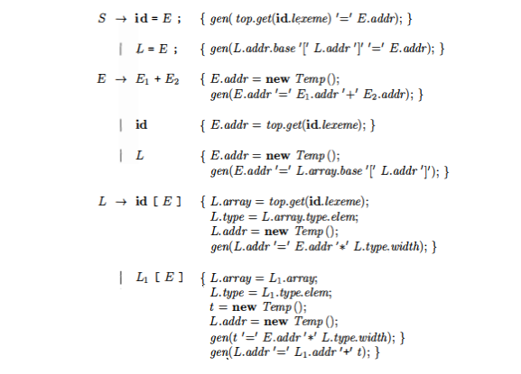
Translation of Array References
L -> L [ E] | id [ E ]

Slide 60
Translation of Array References
Nonterminal L has three synthesized attributes:
1. L.addr denotes a temporary that is used while computing the offset for the array reference by summing the terms i_{j} x w_{j.}
2. L.array is a pointer to the symbol table entry for the array name. The base address of the array, say, L.array.base is used to determine the actual l-value of an array reference after all the index expressions are analyzed.
3. L.type is the type of the sub array generated by L. For any type·t, we assume that its width is given by t.width. We use types as attributes, rather than widths, since types are needed anyway for type checking.
For any array type t, suppose that t.elem gives the element type.
The location for the array reference is therefore L.array.base[L.addr] .

Slide 61
Syntax-Directed Translation Into Three-Address code
The syntax-directed definition for E in a production
id := E, has following two attributes:
E.place - the location (variable name or offset) that holds the value corresponding to the nonterminal.
2. E.code - the sequence of three-address statements representing the intermediate code for the nonterminal.

Slide 62
Syntax-Directed Translation into Three-Address Code for assignment stmt
Grammar:- Semantic rules :-
S → id := E S.code = E.code || gen(‘mov’ E.place ‘, , ’ id.place)
E → E₁ + E₂ E.place = newtemp(); //t1 is created and it’s value assigned to E as E.place
E.code = E₁.code || E₂.code || gen(‘add’ E₁.place ‘,’ E₂.place ‘,’ E.place)
E → id E.place = id.place; // id.place holds value of id
E.code = null // no TAC code for E
S.code → synthesized attribute represents three address code for assignment S
E.place→ the name that will hold the value of E
E.code→ the sequence of three address code evaluating E.
Newtemp() :- function call that returns a sequence of temporary variables t1, t2,…
gen( ) :- generates ICG (TAC) like t1= E₁.place + E₂.place and evaluate it.

Slide 63
Syntax-Directed Translation into Three-Address Code for assignment stmt
S → id := E S.code = E.code || gen(‘mov’ E.place ‘,,’ id.place)
E → E₁ + E₂ E.place = newtemp();
E.code = E₁.code || E₂.code || gen(‘add’ E₁.place ‘,’ E₂.place ‘,’ E.place)
E → E₁ * E₂ E.place = newtemp();
E.code = E₁.code || E₂.code || gen(‘mult’ E₁.place ‘,’ E₂.place ‘,’ E.place)
E → - E₁ E.place = newtemp();
E.code = E₁.code || gen(‘uminus’ E₁.place ‘,,’ E.place)
E → ( E₁ ) E.place = E₁.place;
E.code = E₁.code // ICG of E1 copied to E
E → id E.place = id.place;
E.code = null // no ICG code
S.code → synthesized attribute represents three address code for assignment S
E.place→ the name that will hold the value of E &
E.code→ the sequence of three address code evaluating E.

Slide 64
Translation Scheme to Produce Three-Address Code
S → id := E{ p= lookup(id.name);
if (p is not nil) then emit(‘mov’ E.place ‘,,’ p)
else error(“undefined-variable”) }
E → E₁ + E₂{ E.place = newtemp();
emit(‘add’ E₁.place ‘,’ E₂.place ‘,’ E.place) }
E → E₁ * E₂{ E.place = newtemp();
emit(‘mult’ E₁.place ‘,’ E₂.place ‘,’ E.place)}
lookup() function searches that id in symbol table.
E.place is synthesized attribute.
emit( ) function generates Three address code.

Slide 65
Translation Scheme to Produce Three-Address Code
E → - E₁{ E.place = newtemp();
emit(‘uminus’ E₁.place ‘,,’ E.place) }
E → ( E₁ ){ E.place = E₁.place; }
E → id{ p= lookup(id.name);
if (p is not nil) then E.place = id.place
else error(“undefined-variable”) }

Slide 66

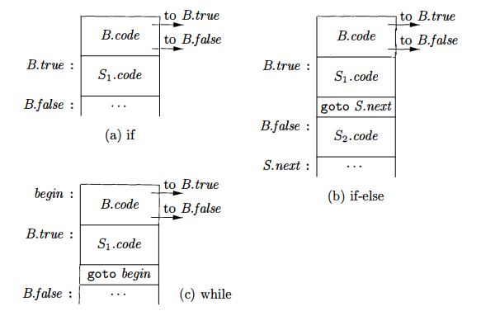

Slide 67
Control Flow statements
newlabel () creates a new label each time it is called, and that label(L) attaches label L to the next three-address instruction to be generated.
We use a local variable begin to hold a new label attached to the first instruction for this while-statement, which is also the first instruction for B.
We use a variable rather than an attribute, because begin is local to the semantic rules for this production

Slide 68
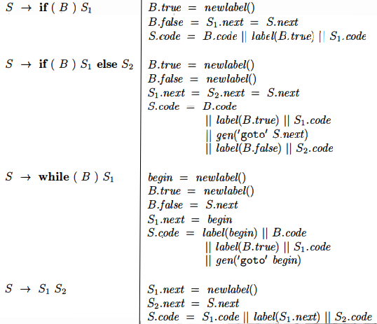
Syntax-Directed Translation for if else and while

Slide 69
Syntax-Directed Translation for if else and while
The code for S -> S1 S2 consists of the code for S1 followed by the code for S2•
The semantic rules manage the labels; the first instruction after the code for S1 is the beginning of the code for S2; and the instruction after the code for S2 is also the instruction after the code for S.

Slide 70
Syntax Directed Translation ( Translation scheme) of Boolean expressions
E → E₁ or E₂{E.place := newtmp()
emit(E.place ':=' E₁.place 'or' E₂.place) }
E → E₁ and E₂ {E.place:= newtmp()
emit(E.place ':=' E₁.place 'and' E₂.place) }
E → not E₁ {E.place := newtmp()
emit(E.place ':=' 'not' E₁.place)}
E → (E₁){E.place = E₁.place }
Notes:
The above written translation scheme produces three address code for Boolean expressions. It is continued to the next page.

Slide 71
Syntax directed translation ( Translation scheme) of Boolean expressions
E → id1 relop id2 {
E.place := newtmp()
emit(if id1.place relop id2.place goto nextstat+3)
emit(E.place = 0)
emit(goto nextstat+2)
emit(E.place = 1) }
E → true {E.place := newtmp()
emit(E.place = '1') }
E → false {E.place := newtmp()
emit(E.place = '0')}
Notes:
In the above scheme, nextstat gives the index of the next three address code in the output sequence and emit increments nextstat after producing each three address statement.

Slide 72
Example: Code for a < b or c < d and e < f
100: if a < b goto 103
101: t_{l} = 0
102: goto 104
103: t_{l} = 1
104: if c < d goto 107
105: t₂ = 0
106: goto 108
107: t₂ = 1
108:if e < f goto 111
109: t₃ = 0
110: goto 112
111: t₃ = 1
112: t₄ = t₂ and t₃
113: t₅ = t_{l} or t₄
Notes:
A relational expression a < b is equivalent to the conditional statement if a < b then 1 else 0 and three address code for this expression is:
100: if a < b goto 103.
101: t = 0
102: goto 104
103: t = 1
104:
It is continued from 104 in the same manner as the above written block.

Slide 73
Syntax-Directed Translation (cont.)
S → if E then S₁ else S₂ S.else = newlabel();
S.after = newlabel(); //S.next
S.code = E.code ||
gen(‘jmpf’ E.place ‘,,’ S.else) || S₁.code ||
gen(‘jmp’ ‘,,’ S.after) ||
gen(S.else ‘:”) || S₂.code ||
gen(S.after ‘:”)
newlabel () creates a new label each time it is called.

Slide 74
Syntax-Directed Translation (cont.)
S → while E do S₁ S.begin = newlabel();
S.after = newlabel();
S.code = gen(S.begin “:”) || E.code ||
gen(‘jmpf’ E.place ‘,,’ S.after) || S₁.code ||
gen(‘jmp’ ‘,,’ S.begin) ||
gen(S.after ‘:”)
newlabel () creates a new label each time it is called, and that label(L) attaches label L to the next three-address instruction to be generated.

Slide 75
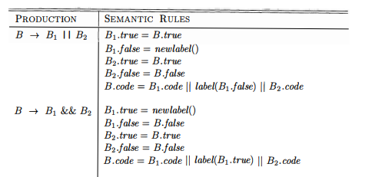
Control-Flow Translation of Boolean Expressions
back

Slide 76
Control-Flow Translation of Boolean Expressions
Suppose B is of the form B1 || B2:-
If B1 is true, then we immediately know that B itself is true, so B1.true is the same as B.true.
If B1 is false, then B2 must be evaluated, so we make B1.false be the label of the first instruction in the code for B2.
The true and false exits of B2 are the same as the true and false exits of B, respectively.

Slide 77
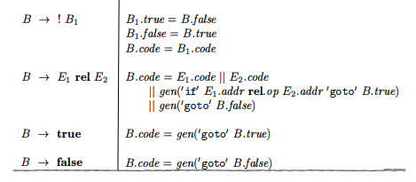
Control-Flow Translation of Boolean Expressions

Slide 78
Control-Flow Translation of Boolean Expressions
No code is needed for an expression B of the form ! B1.
Just interchange the true and false exits of B to get the true and false exits of B1.

Slide 79
Control-Flow Translation of Boolean Expressions
The fourth production B -> E1 reI E2, is translated directly into a comparison three-address instruction with jumps to the appropriate places.
For instance, B of the form a < b translates into:
1. if a < b goto B.true
2. goto B.false
B-> true
B->false
The constants true and false translate into jumps to B.true and
B·false, respectively.

Slide 80
Translation Scheme for Arrays – Example1
A one-dimensional double array A : 5..100
➔ n₁=95 width=8 (double) low₁=5
Intermediate codes corresponding to x := A[y]
mov c,,t1 // where c=base_{A}-(5)*8
mult y,8,t2
mov t1[t2],,t3
mov t3,,x

Slide 81
Translation Scheme for Arrays – Example2
A two-dimensional int array A : 1..10x1..20
➔ n₁=10 n₂=20 width=4 (integers) low₁=1 low₂=1
Intermediate codes corresponding to x := A[y,z]
mult y,20,t1
add t1,z,t1
mov c,,t2 // where c=base_{A}-(1*20+1)*4
mult t1,4,t3
mov t2[t3],,t4
mov t4,,x

Slide 82
Translation Scheme for Arrays – Example3
A three-dimensional int array A : 0..9x0..19x0..29
➔ n₁=10 n₂=20 n₃=30 width=4 (integers) low₁=0 low₂=0 low₃=0
Intermediate codes corresponding to x := A[w,y,z]
mult w,20,t1
add t1,y,t1
mult t1,30,t2
add t2,z,t2
mov c,,t3 // where c=base_{A}-((0*20+0)*30+0)*4
mult t2,4,t4
mov t3[t4],,t5
mov t5,,x

Slide 83
Translation Schemes for Declarations statements
For each name create symbol table entry with information like type and relative address
P → {offset=0} D
D → D ; D
D → id : T {enter(id.name, T.type, offset);
offset = offset + T.width }
T → integer {T.type = integer; T.width = 4}
T → real {T.type = real; T.width = 8}
Notes:
In the translation scheme nonterminal P generates a sequence of declarations of the form id : T . Before the first declaration is considered, offset is set to 0. As each new name is seen, that name is entered in the symbol table with the offset equal to the current value of offset, and offset is incremented by the width of the data object denoted by the name.
The procedure - enter (name, type, offset) creates a symbol-table entry for
name, gives it type and relative address offset in its data area. We use synthesized attributes type and width for nonterminal T to indicate the type and Width, or number of memory units for nonterminal T to indicate the type and width, or number of memory units taken by objects of that type. If type expressions are represented by graphs, then attribute type might be a pointer to the node representing a type expression.
We assume integers to have width of 4 and real to have width of 8. The width of an array is obtained by multiplying the width of each element by the number of elements in the array. The width of each pointer is also assumed to be 4.

Slide 84
Declarations …
T → array [ num ] of T₁
{T.type = array(num.val, T₁.type)
T.width = num.val x T₁.width}
T → ↑T₁
{T.type = pointer(T₁.type)
T.width = 4}
Notes:
Continuation of the example in the last slide.

Slide 85
Boolean Expressions (IMPORTANT)
Compute logical values
Change the flow of control
Boolean operators are: and, or, not
E → E or E
| E and E
| not E
| (E)
| id relop id
| true
| false
Notes:
Boolean expressions are used to compute logical values and as conditional expressions in statements that alter flow of control such as if-then statements. Boolean expressions are composed of the Boolean operators and, or, not - applied to boolean variables or relational expressions.
Relational expressions are of the form E1 relop E2 where E1 and E2 are arithmetic expressions. Boolean expressions can be generated by the following grammar-
E E or E | E and E | not E | (E) | id relop id | true | false

Slide 86
Methods of translation
Evaluated similar to arithmetic expressions
Normally use 1 for true and 0 for false
implemented by flow of control
given expression E₁ or E₂
if E₁ evaluates to true
then “E₁ or E₂” evaluates to true without evaluating E₂
Notes:
There are two principal methods of representing the value of Boolean expressions-
Encode true and false numerically and evaluate analogously to an arithmetic expression. Normally 1 is used to denote true and 0 to denote false.
2. Implementing Boolean expressions by flow of control, that is, representing the value of a Boolean expression by the position reached in the program. For example, consider the expression – a or (b and c). If the value of a is true the values of b and c can be ignored and the entire expression can be assigned the value true. If a is false the value of (b and c) needs to be considered. If the value of b is false, the expression (b and c) and hence the entire expression can be assigned value false. The value of c needs to be considered only if a is false and b is true.

Slide 87
Numerical representation
a or b and not c
Three Adress Code is:
t₁ = not c
t₂ = b and t₁
t₃ = a or t₂
Relational expression a < b is equivalent to
if a < b then 1 else 0
TAC:
1. if a < b goto 4
2. t = 0
3. goto 5
4. t = 1
5.
Notes:
Consider the implementation of Boolean expressions using 1 to denote true and 0 to denote false. Expressions are evaluated in a manner similar to arithmetic expressions.
For example, the three address code for a or b and not c is:
t1 = not c
t2 = b and t1
t3 = a or t2

Slide 88
Short Circuit Evaluation of boolean expressions
Translate boolean expressions without:
generating code for boolean operators
evaluating the entire expression
Flow of control statements
S → if E then S₁
| if E then S₁ else S₂
| while E do S₁
Notes:
We can translate a boolean expression into three-address code without generating code for boolean operators and without evaluating the entire expression. Take the case of the previous example, here we can tell the value of t by whether we reach statement 101 or 103, so the value of t becomes redundant. Similarly, for larger expressions the value can be determined without having to evaluate the expression completely. However, if a part of the expression having a side effect is not evaluated, the side effect will not be visible.

Slide 89
E.true
E.code
E.false
E.true
S₁.code
E.false
S → if E then S₁
E.true = newlabel
E.false = S.next
S₁.next = S.next
S.code = E.code ||
gen(E.true ':') ||
S₁.code
Notes:
Now we will consider the translation of boolean expressions into three address code generated by the following grammar:
S -> if E then S1
| if E then S1 else S2
| while E do S1
where E is the boolean expression to be translated.
Consider the following:
newlabel – returns a new symbolic label each time it is called.
E.true –the label to which control flows if E is true.
E.false –the label to which control flows if E is false.
For if-then
S -> if E then S1
E.true = newlabel //generate a new label for E.true
E.false = S.next //jump to S.next if E is false
S1.next = S.next
S.code = E.code || gen(E.true ':') || S1.code //associate the label created for E.true with the three address code for the first statement for S1

Slide 90
S → if E then S₁ else S₂
E.true = newlabel
E.false = newlabel
S₁.next = S.next
S₂.next = S.next
S.code = E.code ||
gen(E.true ':') ||
S₁.code ||
gen(goto S.next) ||
gen(E.false ':') ||
S₂.code
E.true
E.code
E.false
E.true
S₁.code
goto S.next
E.false
S₂.code
S.next
Notes:
For if-then-else
S -> if E then S1 else S2
E.true = newlabel
E.false = newlabel
S1.next = S.next
S2.next = S.next
S.code = E.code || gen(E.true ':') || S1.code || gen(‘goto’ S.next) || gen(E.false ':') || S2.code
In the above code, the labels E.true and E.false created are associated with the first three address code instructions for S1 and S2 respectively, so that if E is true, jump to S1 occurs and if E is false jump to S2 occurs. An explicit goto S.next is required after the code of S1 to ensure that after execution of code for S1 control moves to the statement after S instead of falling through the code of S2, in case E is true.

Slide 91
S → while E do S₁
S.begin = newlabel
E.true = newlabel
E.false = S.next
S₁.next = S.begin
S.ocde = gen(S.begin ':') || E.code ||
gen(E.true ':') ||
S₁.code ||
gen(goto S.begin)
S.begin
E.true
E.code
E.false
E.true
S₁.code
goto S.begin
E.false
Notes:
For while-do
S -> while E do S1
S.begin = newlabel
E.true = newlabel
E.false = S.next
S1.next = S.begin
S.code = gen(S.begin ':') || E.code || gen(E.true ':') || S1.code || gen(goto S.begin)
In case of while-do statement a new label S.begin is created and associated with the first instruction of the code for E, so that control can be transferred back to E after the execution of S1. E.false is set to S.next, so that control moves out of the code for S in case E is false. Since S1.next is set to S.begin, jumps from the code for S1 can go directly to S.begin.

Slide 92
Control flow translation of boolean expression
E → E₁ or E₂ E₁.true := E.true
E₁.false := newlabel()
E₂.true := E.true
E₂.false := E.false
E.code := E₁.code || gen(E₁.false) || E₂.code
E → E₁ and E₂ E₁.true := newlabel()
E₁ false := E.false
E₂.true := E.true
E₂ false := E.false
E.code := E₁.code || gen(E₁.true) || E₂.code
Notes:
E is translated into a sequence of conditional and unconditional jumps to one of the two locations: E.true or E.false depending if E is true or false.
If E is of the form E1 or E2, then if E1 is true then we immediately know that E itself is true, so E1.true is the same as E.true. If E1 is false then E2 must be evaluated, so E1.false is the label of the first statement of E2. If E2 is evaluated and E2 is true, it implies that E is true, so E2.true is set to E.true. Similarly, if E2 is evaluated and it is false, the entire expression is false.
E -> E1 or E2 E1.true := E.true
E1.false := newlabel
E2.true := E.true
E2.false := E.false
E.code := E1.code || gen(E1.false) || E2.code
Analogously E1 and E2 can also be translated.
Here if E1 is false then there need be no further considerations.
E -> E1 and E2 E1.true := new label
E1 false := E.false
E2.true := E.true
E2 false := E.false
E.code := E1.code || gen(E1.true) || E2.code

Slide 93
Control flow translation of boolean expression …
E → not E₁ E₁.true := E.false
E₁.false := E.true
E.code := E₁.code
E → (E₁) E₁.true := E.true
E₁.false := E.false
E.code := E₁.code
Notes:
For an expression E of the form not E1, just interchange the true and false
exits of E1 to get the true and false exits of E.
E -> not E1 E1.true := E.false
E1.false := E.true
E.code := E1.code
If E is a bracketed expression, it means the same as E1 and so E1.false and E1.true are set to E.false and E.true respectively.
E -> (E1) E1.true := E.true
E1.false := E.false
E.code := E1.code

Slide 94
Control flow translation of boolean expression …
if E is of the form
a < b
then code is of the form
if a < b goto E.true
goto E.false
E → id₁ relop id₂
E.code = gen( if id₁ relop id₂ goto E.true) ||
gen(goto E.false)
E → true E.code = gen(goto E.true)
E → false E.code = gen(goto E.false)
Notes:
if E is of the form a < b then the generated code is of the form:
if a < b goto E.true
goto E.false
E -> id1 relop id2 E.code = gen( if id1 relop id2 goto E.true) ||gen(goto E.false)
E -> true E.code= gen(goto E.true)
E -> false E.code= gen(goto E.false)

Slide 95
Example
Code for a < b or c < d and e < f
if a < b goto Ltrue
goto L1
L1: if c < d goto L2
goto Lfalse
L2: if e < f goto Ltrue
goto Lfalse
Ltrue:
Lfalse:
Notes:
Code for a < b or c < d and e < f
It is equivalent to a<b or (c<d and e<f) by precedence of operators.
Code:
if a < b goto L.true
goto L1
L1 : if c < d goto L2
goto Lfalse
L2 : if e < f goto L.true
goto Lfalse
where Ltrue and Lfalse are the true and false exits for the entire expression.
(The code generated is not optimal as the second statement can be eliminated without changing the value of the code).

Slide 96
Example …
Code for while a < b do
if c<d then
x=y+z
else
x=y-z
L1: if a < b goto L2
goto Lnext
L2: if c < d goto L3
goto L4
L3: t₁ = Y + Z
X= t₁
goto L1
L4: t₁ = Y - Z
X= t₁
goto Ll
Lnext:
Notes:
Code for while a < b do
if c < d then
x = y + z
else
x = y - z
L1 : if a < b goto L2 //no jump to L2 if a>=b. next instruction causes jump outside the loop
goto L.next
L2 : if c < d goto L3
goto L4
L3 : t1 = Y + Z
X= t1
goto L1 //return to the expression code for the while loop
L4 : t1 = Y - Z
X= t1
goto L1 //return to the expression code for the while loop
L.next:
Here too the first two goto statements can be eliminated by changing the direction of the tests (by translating a relational expression of the form id1 < id2 into the statement if id1 id2 goto E.false).

Slide 97
Case Statement
switch expression
begin
case value: statement
case value: statement
….
case value: statement
default: statement
end
evaluate the expression
find which value in the list of cases is the same as the value of the expression.
Default value matches the expression if none of the values explicitly mentioned in the cases matches the expression
execute the statement associated with the value found
Notes:
There is a selector expression, which is to be evaluated, followed by n constant values that the expression can take. This may also include a default value which always matches the expression if no other value does.
The intended translation of a switch case code to:
• evaluate the expression
• find which value in the list of cases is the same as the value of the
expression.
• Default value matches the expression if none of the values explicitly
mentioned in the cases matches the expression
• execute the statement associated with the value found
Most machines provide instruction in hardware such that case instruction can be implemented easily. So, case is treated differently and not as a combination of if-then statements.

Slide 98
Translation
code to evaluate E into t
if t <> V1 goto L1
code for S1
goto next
L1 if t <> V2 goto L2
code for S2
goto next
L2: ……
Ln-2 if t <> Vn-l goto Ln-l
code for Sn-l
goto next
Ln-1: code for Sn
next:
code to evaluate E into t
goto test
L1: code for S1
goto next
L2: code for S2
goto next
……
Ln: code for Sn
goto next
test: if t = V1 goto L1
if t = V2 goto L2
….
if t = Vn-1 goto Ln-1
goto Ln
next: stmt after switch case block
Efficient for n-way branch
Notes:
There are two ways of implementing switch-case statements, both given above.
The above two implementations are equivalent except that in the first case all the jumps are short jumps while in the second case they are long jumps. However, many machines provide the n-way branch which is a hardware instruction. Exploiting this instruction is much easier in the second implementation while it is almost impossible in the first one. So, if hardware has this instruction the second method is much more efficient.

Slide 99
Back Patching
It is a way to implement Boolean expressions and flow of control statements in one pass.
The idea of backpatching is to leave the label unspecified and fill it later once we get it in future.
Intermediate code is generated as quadruples into an array.
Labels are indices into this array.
Notes:
Back patching is a technique to solve the problem of replacing symbolic names in goto statements by the actual target addresses. This problem comes up because of some languages do not allow symbolic names in the branches.
Idea: Maintain a list of branches that have the same target label ( the function backpatch(p,i) does this only) and replace them once they are defined.
Backpatching can be summarized as this:
Two-pass implementation: (1) syntax tree (2) depth-first walk
back-patching (one-pass)
construct the syntax tree
depth-first order tree walk computing translations
generate jumps with unspecified targets (labels)
keep a list of such statements
subsequently fill in the labels (back-patching)
implementation + operations
table of quadruples; labels as indexes into this table
makelist(i) create a new list containing only i
merge(p1, p2) concatenate lists and return pointer
backpatch(p, i) insert i as a target label for each of statements on list with pointer p

Slide 100
Back Patching
a<b or c>d and e<f
100: if a<b goto 106
101: goto 102
102: if c>d goto 104
103: goto 107
104: if e<f goto 106
105: goto 106
106: (true)
107: (false)
106:
107:

Slide 101
Back Patching
Functions in backpatching:
makelist(i): create a newlist containing index i. It returns a pointer to the list.
merge(L1,L2): merge lists pointed to by L1 and L2 and return a pointer to the concatenated list
backpatch(L, label): insert the target label for the statements in the list pointed to by L
nextquad : gives index of next quadruple.
Notes:
Back patching is a technique to solve the problem of replacing symbolic names in goto statements by the actual target addresses. This problem comes up because of some languages do not allow symbolic names in the branches.
Idea: Maintain a list of branches that have the same target label ( the function backpatch(p,i) does this only) and replace them once they are defined.
Backpatching can be summarized as this:
Two-pass implementation: (1) syntax tree (2) depth-first walk
back-patching (one-pass)
construct the syntax tree
depth-first order tree walk computing translations
generate jumps with unspecified targets (labels)
keep a list of such statements
subsequently fill in the labels (back-patching)
implementation + operations
table of quadruples; labels as indexes into this table
makelist(i) create a new list containing only i
merge(p1, p2) concatenate lists and return pointer
backpatch(p, i) insert i as a target label for each of statements on list with pointer p

Slide 102
Boolean Expressions
E → E₁ or M E₂
| E₁ and M E₂
| not E₁
| (E₁)
| id₁ relop id₂
| true
| false
M → Ɛ
Insert a marker non terminal M into the grammar to pick up index or address of next quadruple.
Attributes truelist and falselist are used to generate jump code for boolean expressions
Incomplete jumps are placed on lists pointed to by E.truelist and E.falselist
Notes:
E.truelist and E.falselist have just incomplete jumps as of now. The entries in this list will be given targets (subsequent filling of labels) later on – backpatching.

Slide 103
Boolean expressions …
Consider E → E₁ and M E₂
if E₁ is false then E is also false, so statements in E₁.falselist become part of E.falselist
if E₁ is true then E₂ must be tested, so target of E₁.truelist is beginning of E₂
target is obtained by marker M
attribute M.quad records the number of the first statement of E₂.code
Notes:
Truelist and faliselist are synthesized attributes. If E₁ is false then E is also false so statements in E₁.falselist become part of E.falselist. And if E₁ is true then E₂ must be tested so target of E₁.truelist is beginning of E₂. The target of E₁.truelist is obtained from the marker M with the help of M.quad which records the number ( position) of the first statement of E₂.code because if E₁ is true then the code flow will depend on E₂.

Slide 104
Syntax Directed Translation for Boolean expression using back patching
E → E₁ or M E₂
{backpatch(E₁.falselist, M.quad)
E.truelist = merge(E₁.truelist, E₂.truelist)
E.falselist = E₂.falselist}
E → E₁ and M E₂
{backpatch(E₁.truelist, M.quad)
E.truelist = E₂.truelist
E.falselist = merge(E₁.falselist, E₂.falselist)}
E → not E₁
E.truelist = E₁ falselist
E.falselist = E₁.truelist
E → ( E₁ )
E.truelist = E₁.truelist
E.falselist = E₁.falselist
Notes:
This is the backpatching translation scheme, continued through to the next slide.
E → E₁ or M E₂
In this case
if E1 is false then E2 will be looked into. Hence backpatch(E₁.falselist, M.quad)
If one of E1 or E2 is true then E is true, hence E.truelist = merge(E₁.truelist, E₂.truelist)
If E2 is checked then E1 must have been found to be false, hence Es falselist will be same as E1s falselist. Hence E.falselist = E₂.falselist
E → E₁ and M E₂
In this case if E1 is true then E2 will be looked into. Hence backpatch(E₁.truelist, M.quad)
If one of E1 or E2 is false then E is false, hence E.falselist = merge(E₁.falselist, E₂.falselist)
If E2 checked then E1 must have been found to be true, hence Es truelist will be same as E2s truelist. Hence E.truelist = E₂.truelist
Similarly we can conclude for other two cases given above.

Slide 105
E → id₁ relop id₂
E.truelist = makelist(nextquad)
E.falselist = makelist(nextquad+1)
gen(if id₁ relop id₂ goto --- )
gen(goto ---)
M → Ɛ
M.quad = nextquad // M have the index or address of E2.
// if E1 is false, then we have to evaluate E2 by jumping on E2
Notes:
Note that goto statements have unspecified targets as of now. They will be filled in later on.

Slide 106
Generate code for a < b or c < d and e < f
100: if a < b goto 106
101: goto 102
102: if c < d goto 104
103: goto 107
104: if e < f goto 106
105: goto 107
106: (true)
107: (false)
Initialize nextquad to 100
E.t={100,104}
E.f={103,105}
backpatch(102,104)
E.t={100}
E.f={101}
or
M.q=102
E.t={104}
E.f={103,105}
backpatch(101,102)
Є
a
<
b
E.t={102}
E.f={103}
and
M.q=104
E.t ={104}
E.f={105}
c
<
d
Є
e
<
f
Notes:
Using the rules given in the previous two slides, we finally get the values of E.t and E.f by bottom up evaluation of the tree.
from E => E₁ or M E₂
{ backpatch(E₁.falselist, M.quad); ...}
=>
{ backpatch({101}, 102); ...} gives
101: goto 102
from E => E₁ and M E₂
{ backpatch(E₁.truelist, M.quad); ...}
=>
{ backpatch({102}, 104); ...} gives
102: if c < d goto 104
Note that:
the entire expression is true if the gotos of statements 100 or 104 are reached
the entire expression is false if the gotos of statements 103 or 105 are reached
these targets will be filled in later when the action depending on the true/false is known

Slide 107
Flow of Control Statements
S → if E then S₁
| if E then S₁ else S₂
| while E do S₁
| begin L end
| A
L → L ; S
| S
S : Statement
A : Assignment
L : Statement list
Notes:
The above given example has these flow of control statements of the backpatching grammar. We will attach rules to each reduction for the backpatching. Continue to the next slides to have a look at how to do that.

Slide 108
Position := initial + rate * 60
intermediate code generator
lexical analyzer
temp1 := inttoreal (60)
temp2 := id₃ * temp1
temp3 := id₂ + temp2
id1 := temp3
id₁ := id₂ + id₃ * 60
syntax analyzer
:=
id₁ +
id₂ *
id₃ 60
code optimizer
temp1 := id₃ * 60.0
id1 := id₂ + temp1
code generator
semantic analyzer
MOVF id3, R2
MULF #60.0, R2
MOVF id2, R1
ADDF R2, R1
MOVF R1, id1
:=
id₁ +
id₂ *
id₃ inttoreal
60
The Phases of a Compiler

